Slide 1
Chapter 19 Generics

Slide 2
Objectives
To know the benefits of generics (§19.1).
To use generic classes and interfaces (§19.2).
To declare generic classes and interfaces (§19.3).
To understand why generic types can improve reliability and readability (§19.3).
To declare and use generic methods and bounded generic types (§19.4).
To use raw types for backward compatibility (§19.5).
To know wildcard types and understand why they are necessary (§19.6).
To convert legacy code using JDK 1.5 generics (§19.7).
To understand that generic type information is erased by the compiler and all instances of a generic class share the same runtime class file (§19.8).
To know certain restrictions on generic types caused by type erasure (§19.8).
To design and implement generic matrix classes (§19.9).

Slide 3
Why Do You Get a Warning?
public class ShowUncheckedWarning {
public static void main(String[] args) {
java.util.ArrayList list =
new java.util.ArrayList();
list.add("Java Programming");
}
}
To understand the compile warning on this line, you need to learn JDK 1.6 generics.

Slide 4
Fix the Warning
public class ShowUncheckedWarning {
public static void main(String[] args) {
java.util.ArrayList<String> list =
new java.util.ArrayList<String>();
list.add("Java Programming");
}
}
`
No compile warning on this line.

Slide 5
What is Generics?
Generics is the capability to parameterize types. With this capability, you can define a class or a method with generic types that can be substituted using concrete types by the compiler. For example, you may define a generic stack class that stores the elements of a generic type. From this generic class, you may create a stack object for holding strings and a stack object for holding numbers. Here, strings and numbers are concrete types that replace the generic type.

Slide 6
Why Generics?
The key benefit of generics is to enable errors to be detected at compile time rather than at runtime. A generic class or method permits you to specify allowable types of objects that the class or method may work with. If you attempt to use the class or method with an incompatible object, a compile error occurs.

Slide 7
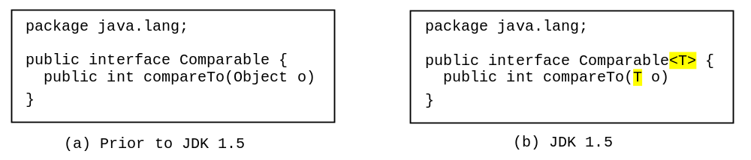
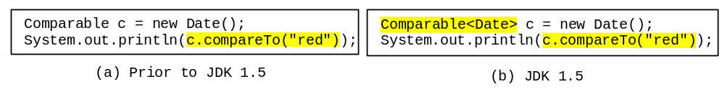
Generic Type
Generic Instantiation
Runtime error
Improves reliability
Compile error

Slide 8
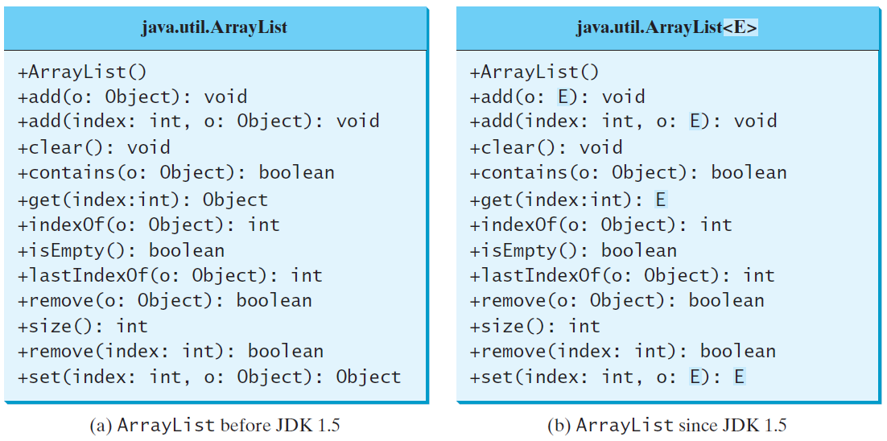
Generic ArrayList in JDK 1.5

Slide 9
Advantage of Generics
Here are mainly 3 advantages of generics. They are as follows:
1) Type-safety: We can hold only a single type of objects in generics. It doesn’t allow to store other objects.
Without Generics, we can store any type of objects.
List list = new ArrayList();
list.add(10);
list.add("10");
//With Generics, it is required to specify the type of object we need to store.
List<Integer> list = new ArrayList<Integer>();
list.add(10);
list.add("10");// compile-time error

Slide 10
Advantage of Generics
2) Type casting is not required: There is no need to typecast the object.
Before Generics, we need to type cast.
List list = new ArrayList();
list.add("hello");
String s = (String) list.get(0);//typecasting
//After Generics, we don't need to typecast the object.
List<String> list = new ArrayList<String>();
list.add("hello");
String s = list.get(0);

Slide 11
Advantage of Generics
3) Compile-Time Checking: It is checked at compile time so problem will not occur at runtime. The good programming strategy says it is far better to handle the problem at compile time than runtime.
Before Generics, we need to type cast.
List<String> list = new ArrayList<String>();
list.add("hello");
list.add(32);//Compile Time Error
Syntax to use generic collection
ClassOrInterface<Type>
Example to use Generics in java
ArrayList<String>

Slide 12
No Casting Needed
ArrayList<Double> list = new ArrayList<>();
list.add(5.5); // 5.5 is automatically converted to new Double(5.5)
list.add(3.0); // 3.0 is automatically converted to new Double(3.0)
Double doubleObject = list.get(0); // No casting is needed
Double d = list.get(1); // Automatically converted to double

Slide 13
Generic Class

Slide 14
General Form of Generic Class
The generics syntax for declaring a generic class:
class class-name<type-param-list> {
// ...
}

Slide 15
class Test<T> {
T obj; // An object of type T is declared
Test(T obj) { // constructor
this.obj = obj;
}
public T getObject() {
return this.obj;
}
public static void main (String[] args){
// instance of Integer type
Test <Integer> iObj = new Test<Integer>(15);
System.out.println(iObj.getObject());
// instance of String type
Test <String> sObj = new Test<String>(“Hello");
System.out.println(sObj.getObject());
}
}

Slide 16
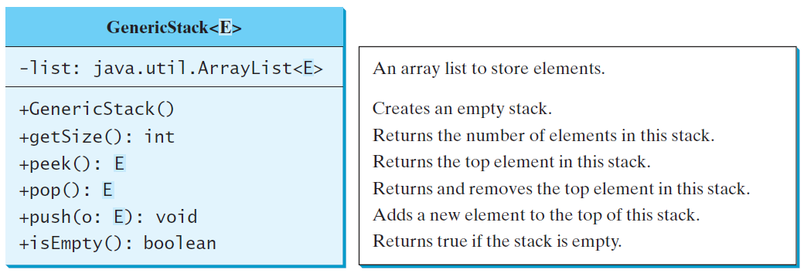
Declaring Generic Classes and Interfaces
GenericStack

Slide 17
Generic method

Slide 18
Generic Methods
public static void print(Object[] list) {
for (int i = 0; i < list.length; i++)
System.out.print(list[i] + " ");
System.out.println();
}
public static <E> void print(E[] list) {
for (int i = 0; i < list.length; i++)
System.out.print(list[i] + " ");
System.out.println();
}

Slide 19
Problem
Create a generic class that contains a method that returns the average of an array of numbers of any type, including integers, floats, and doubles.

Slide 20
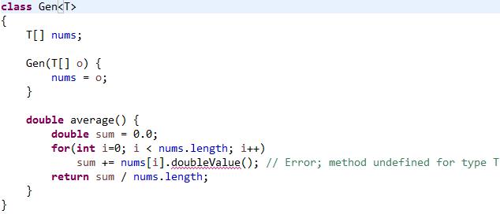
Possible Solution

Slide 21
Possible Solution
Why Error?
The compiler has no way to know that you are intending to create Gen class objects using only numeric types.
When we try to compile Gen class, an error is reported that indicates that the doubleValue( ) method is unknown.
We need some way to tell the compiler that we intend to pass only numeric types to T.

Slide 22
Bounded Types
Used to limit the types that can be passed to a type parameter.
When specifying a type parameter, we can create an upper bound that declares the super-class from which all type arguments must be derived.
<T extends superclass>
A bound can include both a class type and one or more interfaces.
class Gen<T extends MyClass & MyInterface>
Any type argument passed to T must be a subclass of MyClass and implement MyInterface.

Slide 23
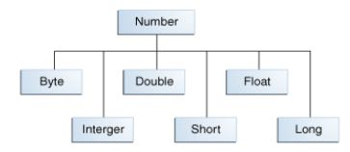
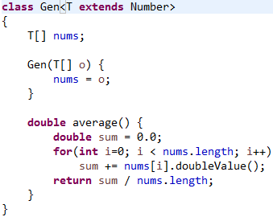
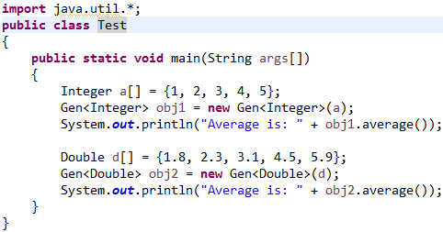
Solution

Slide 24
Bounded Generic Type
public static void main(String[] args ) {
Rectangle rectangle = new Rectangle(2, 2);
Circle circle = new Circle (2);
System.out.println("Same area? " + equalArea(rectangle, circle));
}
public static <E extends GeometricObject> boolean
equalArea(E object1, E object2) {
return object1.getArea() == object2.getArea();
}

Slide 25
Raw Type and Backward Compatibility
The reference type that is formed by taking the name of a generic type declaration without an accompanying type argument list.
An array type whose element type is a raw type.
// raw type
ArrayList list = new ArrayList();
This is roughly equivalent to
ArrayList<Object> list = new ArrayList<Object>();

Slide 26
Raw Type is Unsafe
// Max.java: Find a maximum object
public class Max {
/** Return the maximum between two objects */
public static Comparable max(Comparable o1, Comparable o2) {
if (o1.compareTo(o2) > 0)
return o1;
else
return o2;
}
}
Runtime Error:
Max.max("Welcome", 23);

Slide 27
Make it Safe
// Max1.java: Find a maximum object
public class Max1 {
/** Return the maximum between two objects */
public static <E extends Comparable<E>> E max(E o1, E o2) {
if (o1.compareTo(o2) > 0)
return o1;
else
return o2;
}
}
Max.max("Welcome", 23);

Slide 28
Wildcards
Why wildcards are necessary? See this example.
WildCardNeedDemo
? unbounded wildcard
? extends T bounded wildcard
? super T lower bound wildcard
AnyWildCardDemo
SuperWildCardDemo

Slide 29
Types of wildcards in Java:
1-Upper Bounded Wildcards: These wildcards can be used when you want to relax the restrictions on a variable. For example, say you want to write a method that works on List < integer >, List < double >, and List < number > , you can do this using an upper bounded wildcard.
To declare an upper-bounded wildcard, use the wildcard character (‘?’), followed by the extends keyword, followed by its upper bound.
public static void add(List<? extends Number> list)

Slide 30
//Java program to demonstrate Upper Bounded Wildcards
import java.util.Arrays;
import java.util.List;
class WildcardDemo
{
public static void main(String[] args)
{
//Upper Bounded Integer List
List<Integer> list1= Arrays.asList(4,5,6,7);
System.out.println("Total sum is:"+sum(list1));
List<Double> list2=Arrays.asList(4.1,5.1,6.1);
System.out.print("Total sum is:"+sum(list2));
}
private static double sum(List<? extends Number> list)
{
double sum=0.0;
for (Number i: list)
{
sum+=i.doubleValue();
}
return sum;
}
}
Notes:
Total sum is:22.0 Total sum is:15.299999999999999

Slide 31
Types of wildcards in Java:
2.Lower Bounded Wildcards: It is expressed using the wildcard character (‘?’), followed by the super keyword, followed by its lower bound: <? super A>
Syntax: Collectiontype <? super A>

Slide 32
//Java program to demonstrate Lower Bounded Wildcards
import java.util.Arrays;
import java.util.List;
class WildcardDemo
{
public static void main(String[] args)
{
//Lower Bounded Integer List
List<Integer> list1= Arrays.asList(4,5,6,7);
//Integer list object is being passed
printOnlyIntegerClassorSuperClass(list1);
//Number list
List<Number> list2= Arrays.asList(4,5,6,7);
//Integer list object is being passed
printOnlyIntegerClassorSuperClass(list2);
}
public static void printOnlyIntegerClassorSuperClass(List<? super Integer> list)
{
System.out.println(list);
}
}
Notes:
[4, 5, 6, 7] [4, 5, 6, 7]

Slide 33
Types of wildcards in Java:
3.Unbounded Wildcard: This wildcard type is specified using the wildcard character (?), for example, List. This is called a list of unknown type. These are useful in the following cases
-When writing a method which can be employed using functionality provided in Object class.
-When the code is using methods in the generic class that don’t depend on the type parameter

Slide 34
//Java program to demonstrate Unbounded wildcard
import java.util.Arrays;
import java.util.List;
class unboundedwildcardemo
{
public static void main(String[] args)
{
//Integer List
List<Integer> list1= Arrays.asList(1,2,3);
//Double list
List<Double> list2=Arrays.asList(1.1,2.2,3.3);
printlist(list1);
printlist(list2);
}
private static void printlist(List<?> list)
{
System.out.println(list);
}
}
Notes:
[1, 2, 3] [1.1, 2.2, 3.3]

Slide 35
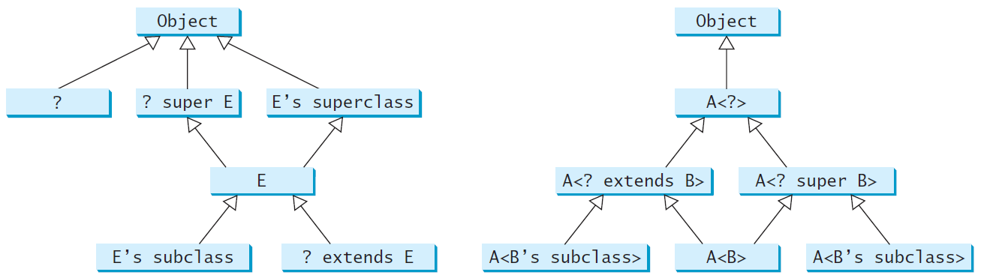
Generic Types and Wildcard Types

Slide 36
Avoiding Unsafe Raw Types
Use
new ArrayList<ConcreteType>()
Instead of
new ArrayList();
TestArrayListNew
Run

Slide 37
Erasure and Restrictions on Generics
Generics are implemented using an approach called type erasure. The compiler uses the generic type information to compile the code, but erases it afterwards. So the generic information is not available at run time. This approach enables the generic code to be backward-compatible with the legacy code that uses raw types.

Slide 38
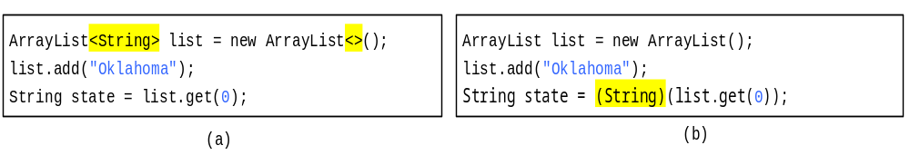
Compile Time Checking
For example, the compiler checks whether generics is used correctly for the following code in (a) and translates it into the equivalent code in (b) for runtime use. The code in (b) uses the raw type.

Slide 39
Important Facts
It is important to note that a generic class is shared by all its instances regardless of its actual generic type.
  GenericStack<String> stack1 = new GenericStack<>();
  GenericStack<Integer> stack2 = new GenericStack<>();
Although GenericStack<String> and GenericStack<Integer> are two types, but there is only one class GenericStack loaded into the JVM.

Slide 40
Restrictions on Generics
Restriction 1: Cannot Create an Instance of a Generic Type. (i.e., new E()).
Restriction 2: Generic Array Creation is Not Allowed. (i.e., new E[100]).
Restriction 3: A Generic Type Parameter of a Class Is Not Allowed in a Static Context.
Restriction 4: Exception Classes Cannot be Generic.

Slide 41
Designing Generic Matrix Classes
Objective: This example gives a generic class for matrix arithmetic. This class implements matrix addition and multiplication common for all types of matrices.
GenericMatrix

Slide 42
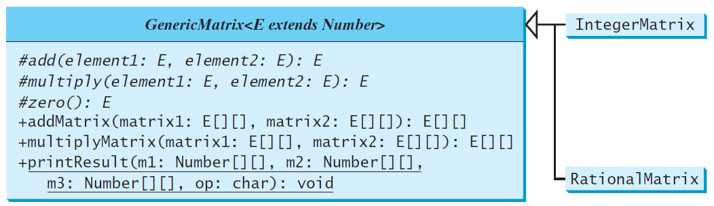
UML Diagram

Slide 43
Source Code
Objective: This example gives two programs that utilize the GenericMatrix class for integer matrix arithmetic and rational matrix arithmetic.
IntegerMatrix
TestIntegerMatrix
Run
RationalMatrix
TestRationalMatrix
Run

